Slide 1
Project Title: Churn Analysis using Power BI and SQL and ml
Your Name : abdul amaan
Date

Slide 2
Overview:
The project aims to analyze customer churn and predict potential churners for a company using Power BI for visualization and SQL for database management.
The analysis includes visualizing metrics like total churn, churn rate, and customer segmentation based on different factors.
Objective:
To identify patterns and trends related to customer churn.
Predict which customers are likely to churn using machine learning models, specifically Random Forest.

Slide 3
. Problem Statement
Churn Issue:
The company faces the challenge of understanding why customers leave (churn) and identifying patterns to prevent it.
Understanding customer retention is critical for business growth and strategy.
Why it’s important:
Reducing churn is more cost-effective than acquiring new customers.
Identifying customers at risk of leaving helps improve retention strategies.

Slide 4
Scope of the Project:
Data Handling:
Creating and managing the SQL database to store customer data, including details like customer ID, tenure, payment methods, etc.
Developing views for churned customers and newly joined customers for analysis and machine learning.
Analysis:
Visualizing key metrics like churn rate, total churn, total customers, and total joined customers using Power BI.
Filtering data based on demographics such as state, marital status, gender, payment method, and internet type.
Machine Learning:
Predicting churn using a Random Forest model.
Evaluating the model’s performance and applying it to new customer data

Slide 5
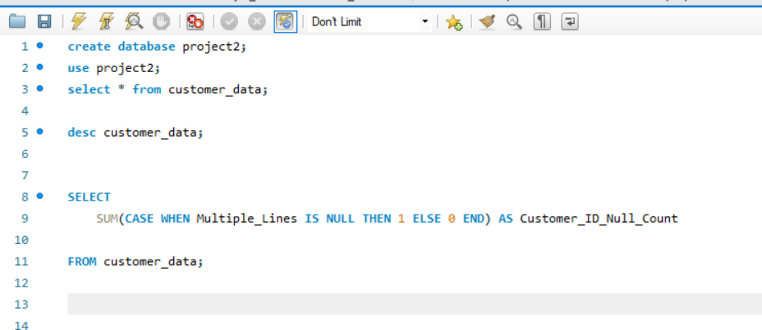
SQL DATABASE CREATION

Slide 6
Methodology
SQL Database:
Built the database and created necessary views for churn analysis and newly joined customers.
Example views:
Churned customers: List of customers who have left.
Recently joined customers: Data used for machine learning model predictions.
Power BI Integration:
Linked Power BI to the SQL database to fetch live data.
Created necessary metrics like:
Total churn
Churn rate
Total customers and joined customers
Used filters like state, marital status, payment method, and internet type to segment the data.

Slide 7
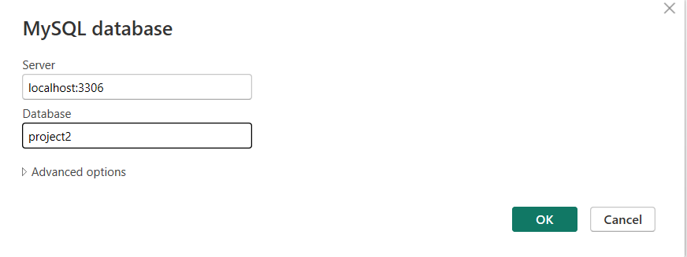
Connection with mysql database

Slide 8
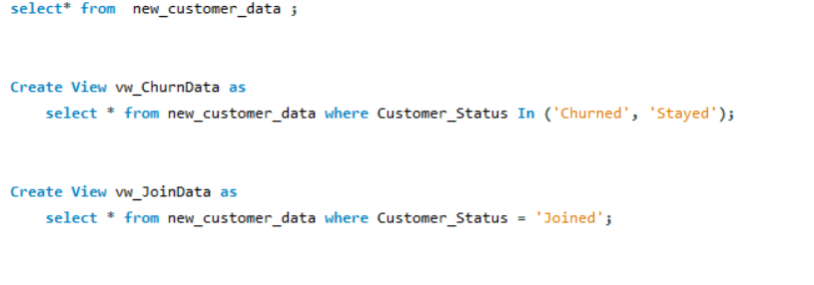
NECESSARY TABLE AND VIEW FOR POWER BI connection

Slide 9
IMPORTANT METRICS IN POWER BI
Visualizations:
Total churn by gender, state, payment method, internet type.
Total customers and churn by tenure group and contract type.
Used slicers and filters to interact with data dynamically.

Slide 10
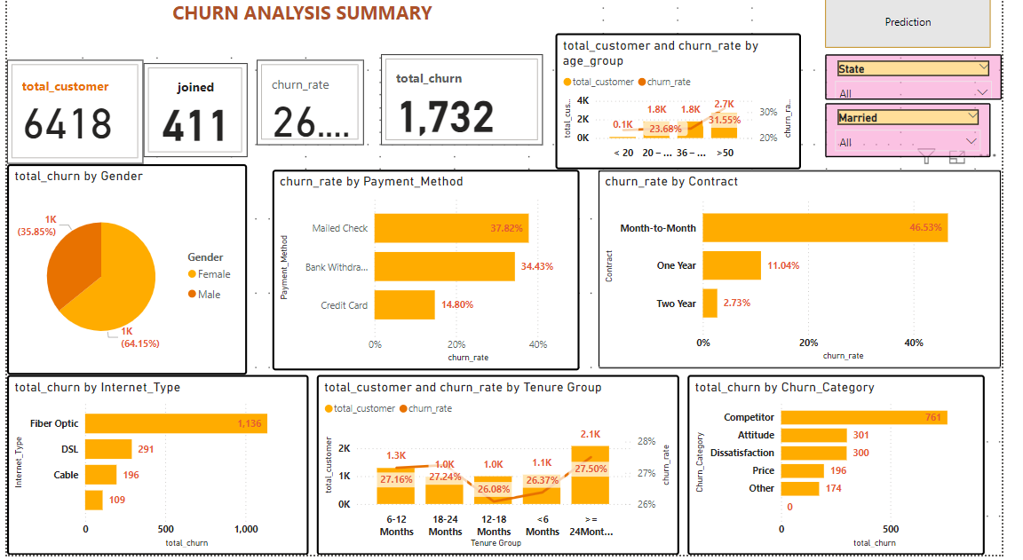
Power bi dashboard

Slide 11
Machine Learning Model
Model: Random Forest
Trained a Random Forest model to predict customer churn based on the data from SQL.
Used Y_train data for training and tested the model’s accuracy and performance.
Model Application:
Imported new customer data from Excel (newly joined customers).
Applied the trained model to predict the churn risk (binary output: churn or not).
Filtered customers likely to churn (output = 1).
Model Evaluation:
Evaluated the model performance using appropriate metrics (accuracy, precision, recall, F1-score).

Slide 12
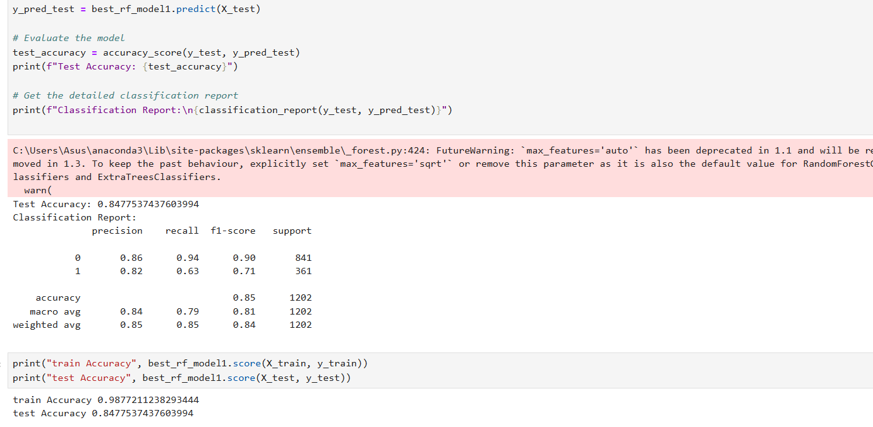
Ml confussion metrics for performance of model and score .

Slide 13
Results and Findings
Power BI Visualizations:
Showed key visualizations including total churn, churn rate, and customer distribution by various filters.
Visualized the churn by gender, state, payment method, and internet type.
Displayed age group, customer ID, payment method, and marital status of customers most likely to churn.
Model Prediction Results:
The model was able to predict potential churners with a certain level of accuracy.
New customers who are likely to churn were flagged and displayed in the Power BI dashboard.

Slide 14
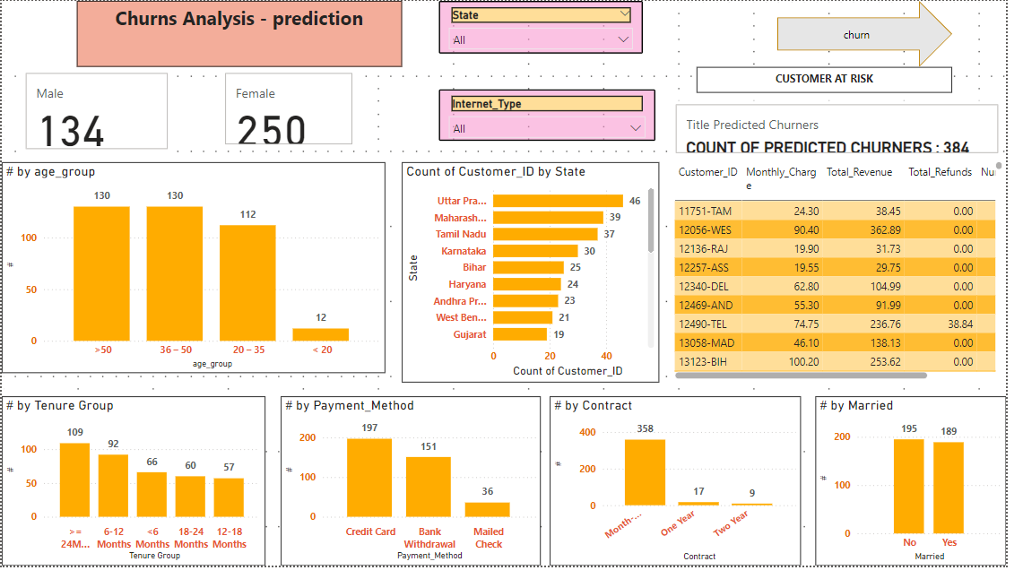

Slide 15
Conclusion
Key Takeaways:
SQL database management and Power BI integration helped in effectively analyzing churn metrics.
The Random Forest model provided useful predictions for churn, which can assist in strategic decisions.
Impact:
By identifying customers at risk of leaving, businesses can take proactive measures to retain valuable customers.
Future Work:
Further fine-tuning of the machine learning model.
Integration of more customer features to improve predictions.

